Slide 1
Chapter 1
Introduction

Slide 2
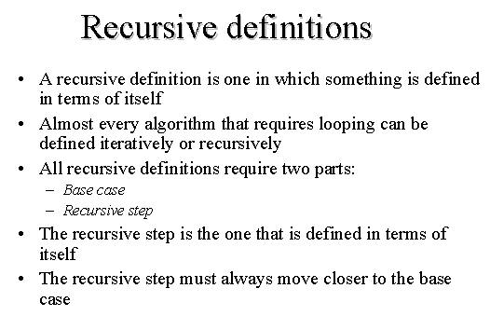
Recursive and Non recursive algorithms

Slide 3
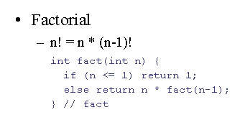
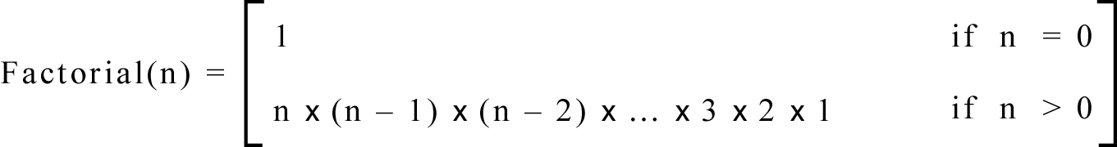
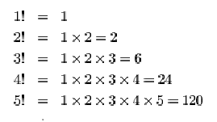
In general, we can define the factorial function in the following way:

Slide 4
Iterative Definition
This is an iterative definition of the factorial function.
It is iterative because the definition only contains the algorithm parameters and not the algorithm itself.
This will be easier to see after defining the recursive implementation.

Slide 5
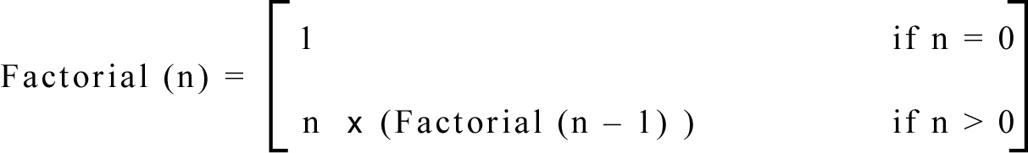
Recursive Definition
We can also define the factorial function in the following way:

Slide 6
Iterative vs. Recursive
Function does NOT calls itself
Iterative 1 if n=0
factorial(n) =
n x (n-1) x (n-2) x … x 2 x 1 if n>0
Recursive factorial(n) =
1 if n=0 n x factorial(n-1) if n>0
Function calls itself

Slide 7
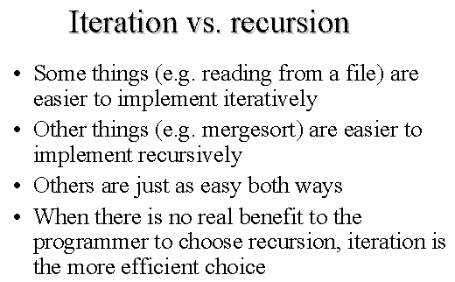
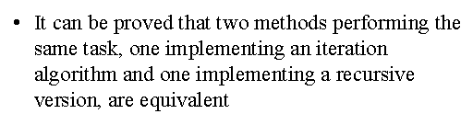

Slide 8
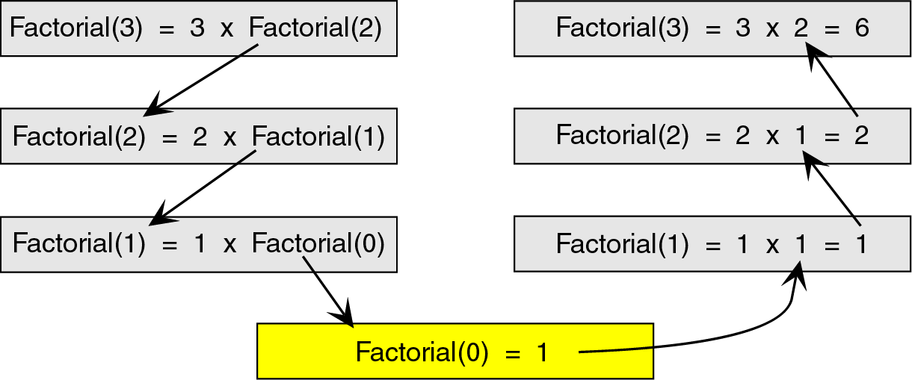
Recursion
To see how the recursion works, let’s break down the factorial function to solve factorial(3)

Slide 9
Breakdown
Here, we see that we start at the top level, factorial(3), and simplify the problem into 3 x factorial(2).
Now, we have a slightly less complicated problem in factorial(2), and we simplify this problem into 2 x factorial(1).

Slide 10
Breakdown
We continue this process until we are able to reach a problem that has a known solution.
In this case, that known solution is factorial(0) = 1.
The functions then return in reverse order to complete the solution.

Slide 11
Breakdown
This known solution is called the base case.
Every recursive algorithm must have a base case to simplify to.
Otherwise, the algorithm would run forever (or until the computer ran out of memory).

Slide 12
Breakdown
The other parts of the algorithm, excluding the base case, are known as the general case.
For example: 3 x factorial(2) ➔ general case 2 x factorial(1) ➔ general case etc …

Slide 13
Iteration vs. Recursion
Now that we know the difference between an iterative algorithm and a recursive algorithm, we will develop both an iterative and a recursive algorithm to calculate the factorial of a number.
We will then compare the 2 algorithms.

Slide 14
Iterative Algorithm
factorial(n) {
i = 1
factN = 1
loop (i <= n)
factN = factN * i
i = i + 1
end loop
return factN
}
The iterative solution is very straightforward. We simply loop through all the integers between 1 and n and multiply them together.

Slide 15
Recursive Algorithm
Note how much simpler the code for the recursive version of the algorithm is as compared with the iterative version ➔
we have eliminated the loop and implemented the algorithm with 1 ‘if’ statement.
factorial(n) {
if (n = 0) return 1
else
return n*factorial(n-1)
end if
}

Slide 16
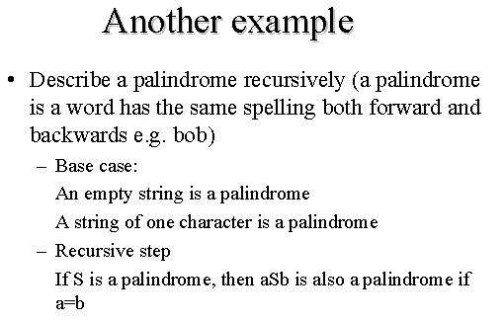

Slide 17
How recursion works
To truly understand how recursion works we need to first explore how any function call works.
When a program calls a subroutine (function) the current function must suspend its processing.
The called function then takes over control of the program. When the function is finished, it needs to return to the function that called it.
The calling function then ‘wakes up’ and continues processing.
One important point in this interaction is that, unless changed through call-by-reference, all local data in the calling module must remain unchanged.

Slide 18
Therefore, when a function is called, some information needs to be saved in order to return the calling module back to its original state (i.e., the state it was in before the call).
We need to save information such as the local variables and the spot in the code to return to after the called function is finished
To do this we use a stack.
Before a function is called, all relevant data is stored in a stackframe.
This stackframe is then pushed onto the system stack.
After the called function is finished, it simply pops the system stack to return to the original state.

Slide 19
By using a stack, we can have functions call other functions which can call other functions, etc.
Because the stack is a first-in, last-out data structure, as the stackframes are popped, the data comes out in the correct order.

Slide 20
Two criteria are used to judge algorithms:
(i) time complexity (ii) space complexity.
Space Complexity of an algorithm is the amount of memory it needs to run to completion.
Time Complexity of an algorithm is the amount of CPU time it needs to run to completion.
Space Complexity:
Memory space S(P) needed by a program P, consists of two components:
A fixed part: needed for instruction space (byte code), simple variable space, constants space etc. → c
A variable part: dependent on a particular instance of input and output data. → S_{p}(instance)
S(P) = c + S_{p}(instance characteristics)

Slide 21
Space complexity example:
Algorithm abc (a, b, c)
{
return a+b+b*c+(a+b-c)/(a+b)+4.0;
}

Slide 22
For every instance 3 computer words required to store variables: a, b, and c. Therefore
S_{p}()= 3. S(P) = 3.

Slide 23
Algorithm Sum(a[ ], n)
{
s:= 0.0;
for i = 1 to n do
s := s + a[i];
return s;
}

Slide 24
Every instance needs to store array a[] & n.
Space needed to store n = 1 word.
Space needed to store a[ ] = n floating point words (or at least n words)
Space needed to store i and s = 2 words
S_{p}(n) = (n + 3). Hence S(P) = (n + 3).

Slide 25
Space Complexity
Space complexity is a measure of the amount of working storage an algorithm needs. That means how much memory, in the worst case, is needed at any point in the algorithm.
int sum(int x, int y, int z)
{ int r = x + y + z;
return r; }.
requires 3 units of space for the parameters and 1 for the local variable, and this never changes, so this is O(1).

Slide 26
Time Complexity
Time required T(P) to run a program P also consists of two components:
A fixed part: compile time which is independent of the problem instance → c.
A variable part: run time which depends on the problem instance → t_{p}(instance)
T(P) = c + t_{p}(instance characteristic)
How to measure T(P)?
Measure experimentally, using a “stop watch”
→ T(P) obtained in secs, msecs.
Count program steps → T(P) obtained as a step count.
Fixed part is usually ignored; only the variable part t_{p}() is measured.

Slide 27
What is a program step?
a+b+b*c+(a+b)/(a-b) → one step;
comments → zero steps;
while (<expr>) do → step count equal to the number of times <expr> is executed.
for i=<expr> to <expr1> do → step count equal to number of times <expr1> is checked.

Slide 28
 | Statements | S/E | Freq. | Total
1 | Algorithm Sum(a[ ],n) | 0 | - | 0
2 | { | 0 | - | 0
3 | S = 0.0; | 1 | 1 | 1
4 | for i=1 to n do | 1 | n+1 | n+1
5 | s = s+a[i]; | 1 | n | n
6 | return s; | 1 | 1 | 1
7 | } | 0 | - | 0
2n+3

Slide 29
 | Statements | S/E | Freq. | Total
1 | Algorithm Sum(a[ ],n,m) | 0 | - | 0
2 | { | 0 | - | 0
3 | for i=1 to n do; | 1 | n+1 | n+1
4 | for j=1 to m do | 1 | n(m+1) | n(m+1)
5 | s = s+a[i][j]; | 1 | nm | nm
6 | return s; | 1 | 1 | 1
7 | } | 0 | - | 0
2nm+2n+2

Slide 30
Example: f(n) = 10n²+4n+2
is O(n²) because 10n²+4n+2 <= 11n²
for all n >=5.
Example: f(n) = 6*2^{n}+n² is O(2^{n})
because 6*2^{n}+n² <=7*2^{n} for all n>=4.
Algorithms can be: O(1) → constant;
O(log n) → logarithmic;
O(nlogn); O(n)→ linear;
O(n²) → quadratic;
O(n³) → cubic;
O(2^{n}) → exponential.

Slide 31
Some results
Sum of two functions: If f(n) = f₁(n) + f₂(n), and f₁(n) is O(g₁(n)) and f₂(n) is O(g₂(n)), then f(n) = O(max(|g₁(n)|, |g₂(n)|)).
Product of two functions: If f(n) = f₁(n)* f₂(n), and f₁(n) is O(g₁(n)) and f₂(n) is O(g₂(n)), then f(n) = O(g₁(n)* g₂(n)).

Slide 32
int sum(int a[], int n)
{ int r = 0;
for (int i = 0; i < n; ++i)
{ r += a[i]; }
return r; }
requires N units for a, plus space for n, r and i, so it's O(N).

Slide 33
Asymptotic Notation
Asymptotic analysis is to have a measure of efficiency of algorithms that doesn’t depend on machine specific constants, and doesn’t require algorithms to be implemented and time taken by programs to be compared.
Asymptotic notations are mathematical tools to represent time complexity of algorithms for asymptotic analysis.
The following 3 asymptotic notations are mostly used to represent time complexity of algorithms.

Slide 34
Θ Notation:
The theta notation bounds a functions from above and below, so it defines exact asymptotic behavior. A simple way to get Theta notation of an expression is to drop low order terms and ignore leading constants.
For example, consider the following expression. 3n³ + 6n² + 6000 = Θ(n³) Dropping lower order terms is always fine because there will always be a n0 after which Θ(n³) beats Θ(n²) irrespective of the constants involved. For a given function g(n), we denote Θ(g(n)) is following set of functions.

Slide 35
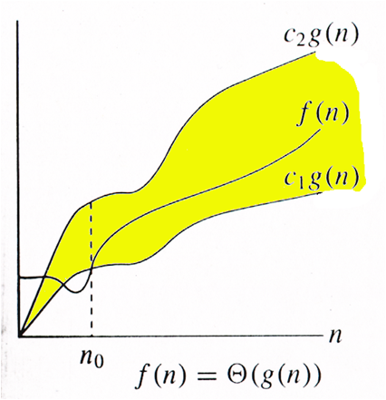

Slide 36
Θ(g(n)) = { f(n): there exist positive constants c1, c2 and n₀
such that 0 <= c1*g(n) <= f(n) <= c2*g(n)
for all n >= n0
}
The above definition means, if f(n) is theta of g(n), then the value f(n) is always between c1*g(n) and c2*g(n) for large values of n (n >=n0). The definition of theta also requires that f(n) must be non-negative for values of n greater than n₀.

Slide 37
Big O Notation:
The Big O notation defines an upper bound of an algorithm, it bounds a function only from above.
Big O of a function gives us ‘rate of growth’ of the step count function f(n), in terms of a simple function g(n), which is easy to compare.
For example : Consider the case of Insertion Sort. It takes linear time in best case and quadratic time in worst case. We can safely say that the time complexity of Insertion sort is O(n²). Note that O(n²) also covers linear time.
If we use Θ notation to represent time complexity of Insertion sort, we have to use two statements for best and worst cases: 1. The worst case time complexity of Insertion Sort is Θ(n²). 2. The best case time complexity of Insertion Sort is Θ(n).
The Big O notation is useful when we only have upper bound on time complexity of an algorithm. Many times we easily find an upper bound by simply looking at the algorithm.

Slide 39
O(g(n)) = { f(n): there exist positive constants c and n₀ such that 0 <= f(n) <= c*g(n)
for all n >= n0
}
Example: f(n) = 3n+2 is O(n) because 3n+2 <= 4n for all n >= 2. c = 4, n₀ = 2. Here g(n) = n.
F(n) = 3n + 3 = O (n) as 3n+3 <= 4n for all n>=3.
F(n) = 100n + 6 = O(n) as 100n + 6 <=101n for all n>=6.
F(n) = 10n^2+4n+2 <=11n^2

Slide 40
Suppose f(n) = 5n and g(n) = n. • To show that f = O(g), we have to show the existence of a constant C as given earlier. Clearly 5 is such a constant so f(n) = 5 * g(n). • We could choose a larger C such as 6, because the definition states that f(n) must be less than or equal to CS 4407, Algorithms , University College Cork,, Gregory M. Provan C * g(n), but we usually try and find the smallest one. Therefore, a constant C exists (we only need one) and f = O(g).
In the previous timing analysis, we ended up with T(n) = 4n + 5, and we concluded intuitively that T(n) = O(n) because the running time grows linearly as n grows. Now, however, we can prove it mathematically: To show that f(n) = 4n + 5 = O(n), we need to produce a constant C such that: f(n) <= C * n for all n. If we try C = 4, this doesn't work because 4n + 5 is not less than 4n. We need C to be at least 9 to cover all n. If n = 1, C has to be 9, but C can be smaller CS 4407, Algorithms , University College Cork,, Gregory M. Provan for greater values of n (if n = 100, C can be 5). Since the chosen C must work for all n, we must use 9: 4n + 5 <= 4n + 5n = 9n Since we have produced a constant C that works for all n, we can conclude: T(4n + 5) = O(n)

Slide 41
Say f(n) = n2: We will prove that f(n) ≠ O(n). • To do this, we must show that there cannot exist a constant C that satisfies the big-Oh definition. We will prove this by contradiction. Suppose there is a constant C that works; then, by the definition of big-Oh: n2 ≤ C * n for all n. • Suppose n is any positive real number greater than C, CS 4407, Algorithms , University College Cork,, Gregory M. Provan then: n * n > C * n, or n2 > C * n. So there exists a real number n such that n2 > C * n. This contradicts the supposition, so the supposition is false. There is no C that can work for all n: f(n) ≠ O(n) when f(n) = n2
Suppose f(n) = n2 + 3n - 1. We want to show that f(n) = O(n2). f(n) = n2 + 3n - 1 < n2 + 3n (subtraction makes things smaller so drop it) <= n2 + 3n2 (since n <= n2 for all integers n) = 4n2 Therefore, if C = 4, we have shown that f(n) = O(n2). Notice that all we are doing is finding a simple function that is an upper bound on the original function. Because of this, we could also say that CS 4407, Algorithms , University College Cork,, Gregory M. Provan This would be a much weaker description, but it is still valid. f(n) = O(n3) since (n3) is an upper bound on n2

Slide 42
Ω Notation: Just as Big O notation provides an asymptotic upper bound on a function, Ω notation provides an asymptotic lower bound.
Ω Notation : can be useful when we have lower bound on time complexity of an algorithm.
The best case performance of an algorithm is generally not useful, the Omega notation is the least used notation among all three.
For a given function g(n), we denote by Ω(g(n)) the set of functions.

Slide 43
Ω (g(n)) = { f(n) : there exist positive constants c and n₀ such that 0 <= c*g(n) <= f(n)
for all n >= n0
}.

Slide 44
Definition (Theta) : Consider a function f(n) which is non-negative for all integers . We say that ``f(n) is theta g(n),'' which we write , if and only if f(n) is O(g(n)) and f(n) is .
Definition (Little Oh) : Consider a function f(n) which is non-negative for all integers. We say that ``f(n) is little oh g(n),'' which we write f(n)=o(g(n)), if and only if f(n) is O(g(n)) but f(n) is not.
Little oh notation represents a kind of loose asymptotic bound in the sense that if we are given that f(n)=o(g(n)), then we know that g(n) is an asymptotic upper bound since f(n)=O(g(n)), but g(n) is not an asymptotic lower bound since f(n)=O(g(n)) and implies that.
For example, consider the function f(n)=n+1.
what c we choose, for large enough n, . Thus, we may write .

Slide 45
Suppose f(n) = 5n and g(n) = n. • To show that f = O(g), we have to show the existence of a constant C as given earlier. Clearly 5 is such a constant so f(n) = 5 * g(n). • We could choose a larger C such as 6, because the definition states that f(n) must be less than or equal to
C * g(n), but we usually try and find the smallest one. Therefore, a constant C exists (we only need one) and f = O(g).

Slide 46
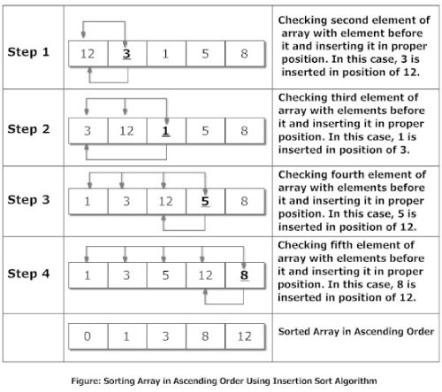

Slide 47
Insertion Sort
for(i=1; i<n ; i++)
{ temp = data[i];
j=i-1;
while(temp<data[j] && j>=0)
{data[j+1] = data[j]; --j; }
data[j+1]=temp; }
printf("In ascending order: ");
for(i=0; i<n; i++)
printf("%d\t",data[i]);
return 0; }

Slide 48
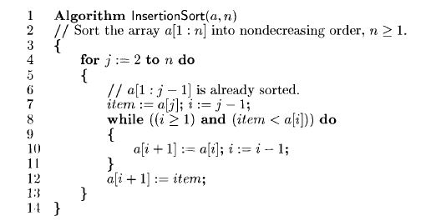

Slide 49
Time Complexity of insertion sort :
If we take a closer look at the insertion sort code, we can notice that every iteration of while loop reduces one inversion. The while loop executes only if i > j and arr[i] < arr[j]. Therefore total number of while loop iterations (For all values of i) is same as number of inversions. Therefore overall time complexity of the insertion sort is O(n + f(n)) where f(n) is inversion count. If the inversion count is O(n), then the time complexity of insertion sort is O(n). In worst case, there can be n*(n-1)/2 inversions. The worst case occurs when the array is sorted in reverse order. So the worst case time complexity of insertion sort is O(n²).

Slide 50
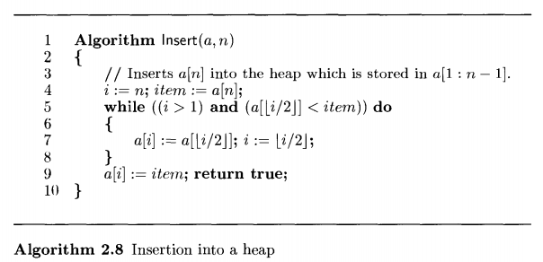

Slide 51

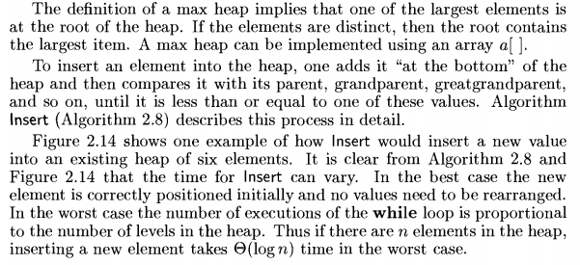
Heaps & Heap Sort

Slide 52
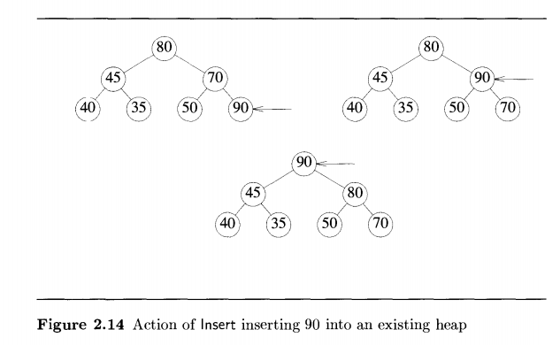

Slide 53
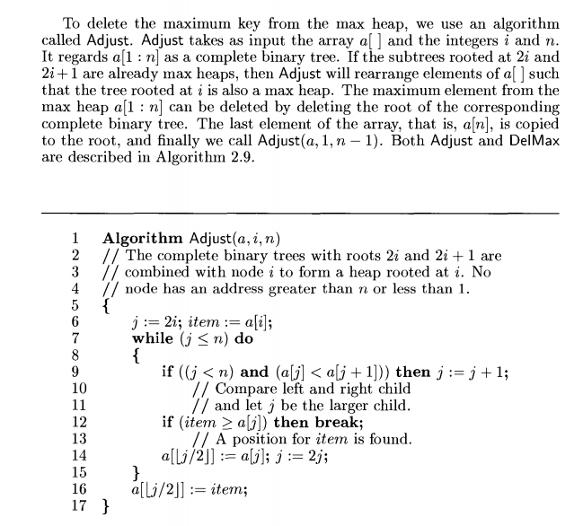

Slide 54
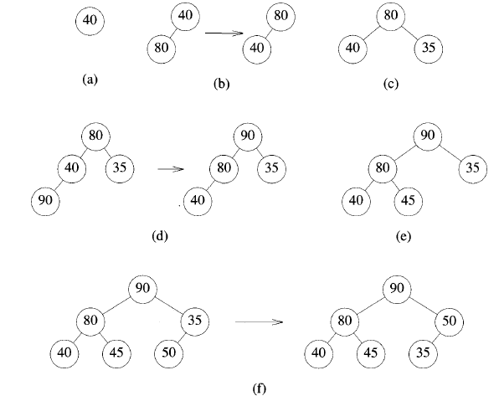

Slide 55
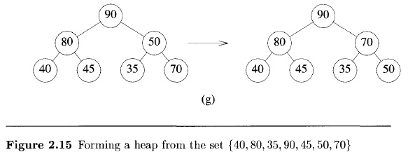

Slide 56
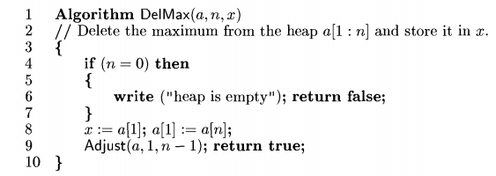

Slide 57
